Slide 1

TARA
by NewYug Technologies
Mentored by Goa IT Professionals
Mission:
Make it convenient for every citizen to use Public Transport, saving fuel and protecting the environment.

Slide 2
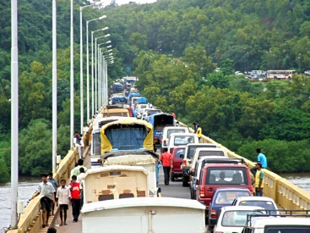
Problem
Rampant rise in personal vehicles
Major toll on the state's infrastructure, peacefulness and environment
Lack of awareness of public transport options

Slide 3
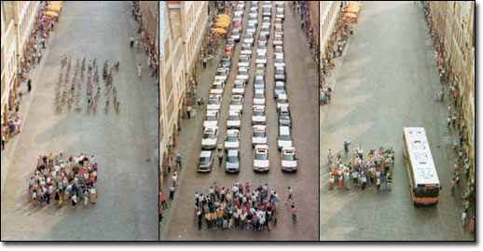
Solution
Provide public transport timetables and boarding points to citizens
Upload time-tables and boarding points to Google
Google displays public transport options on map
People will be able to plan their commute in advance
Gradual decrease in use of personal vehicles

Slide 4


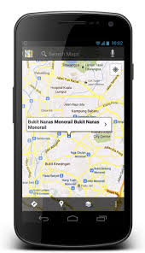
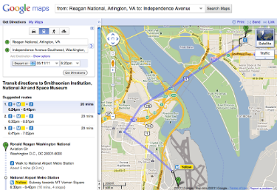
Product – The TARA Project
Transit Agency Route Administrator (TARA)
Allows the transit agency to visually define the details of their fleet such as stops, routes, trips and timings.
Allows the fleet details to be managed on a Google Map using a very intuitive User Interface that greatly simplifies the entire process of uploading the data to Google.
Is multi-tenant and hence allows employees of multiple agencies to simultaneously work on the same product.
Provide fleet settings
TARA
GTFS data
Travel options
Google Maps on mobile
Google Maps on website

Slide 5
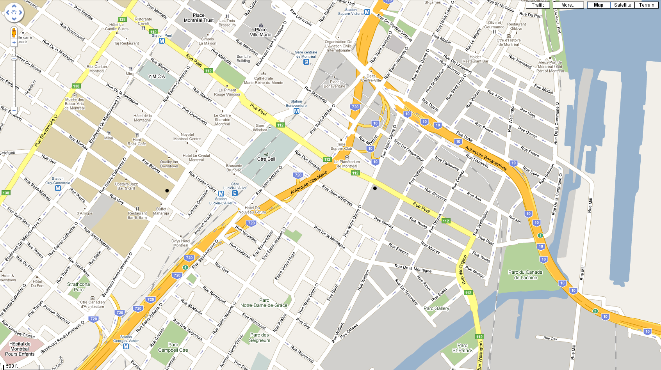

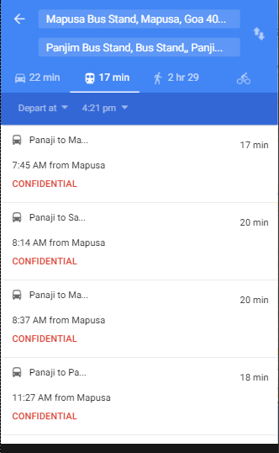
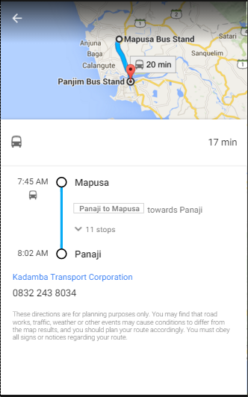
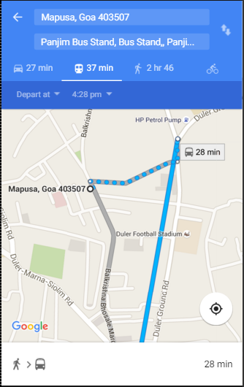
Passenger Experience on Google Maps
Timings for different trips from source to destination
Detailed display of chosen trip on a route
Step-by-step directions including different modes such as Walking, Ferries, and Buses.

Slide 6
Our plus points
A company in Europe offers similar service at an annual rate of 13 Lakhs for 250 routes.
We are not aware of any other prominent company that provides an equivalent service in India.
The TARA application provides a much more simplified user interface for data entry that the competing application.
Unique features
Auto-completion of trip timings
Support for stops across either side of roads

Slide 7
Achievements
Partnership with Kadamba and Goa Ferry Service
Got insights into operations of Transit agencies
Gone Live on 3 Sep 2016
Further Data entry in progress
Started with data entry for Maharashtra State Transport Corporation
Future enhancements
Further Improve the User Interface.
Include bus fare details on Google.
Once the time-table data is digitized, it can be presented to citizens through multiple additional channels such as SMS, IVR, websites, etc.
Passenger-experience can be further enhanced by providing real-time status updates of every trip provided the transit agencies install GPS devices.

Slide 8
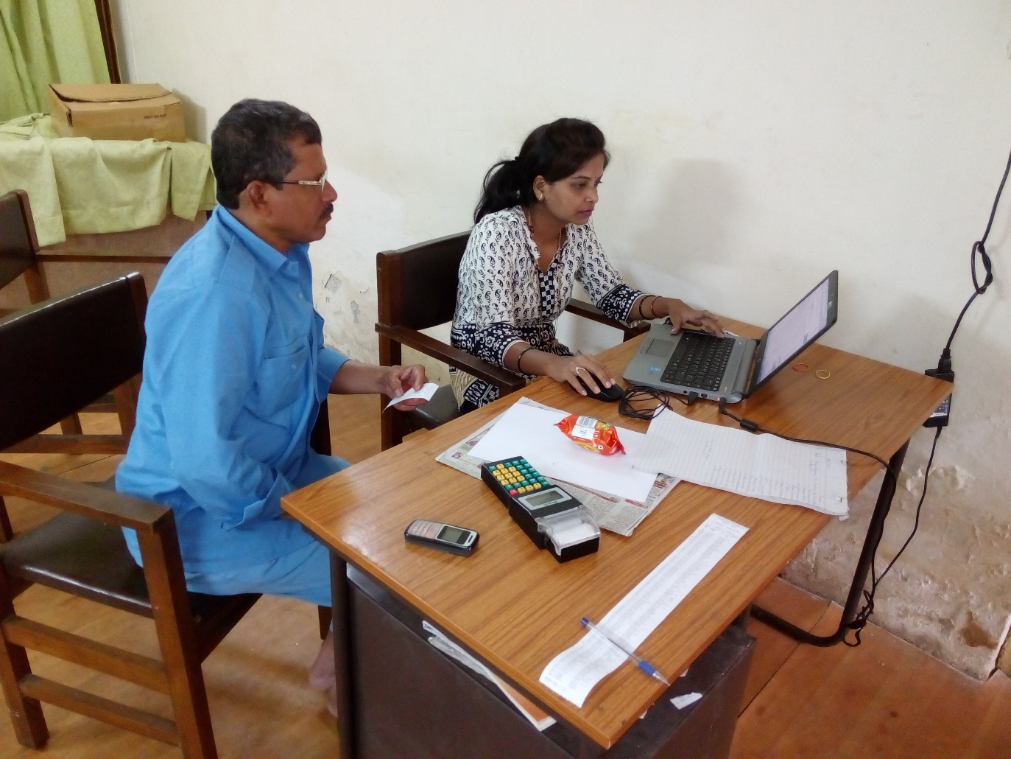
Points to note
Data entry operators need training to perform data entry
The best source of precise stop locations is a driver or a conductor
Data entry is done most effectively from a bus depot where drivers or conductors are present
Google performs extensive testing on uploaded data
It takes about 6 months to make the data Live on Google

Slide 9
TARA for Panaji - Goa
Our approach
Pull data from existing systems into TARA.
These may be Excel files or any other electronic format.
The files should have routes and timing information.
If such data is not available in electronic form, the TARA system allows manual data entry
Train employees of Dept. of Transport to mark stop locations
Drivers/Conductors assist employees to locate stops on a map.
Data from TARA is exported to GTFS format expected by Google.
Google shows data on Google Maps.

Slide 10
Pricing
At least 10% increase in passengers is expected
Annual subscription for TARA service is based on number of routes
Subscription cost for 1st year is decided based on amount of effort for uploading data.
Subscription cost for 2nd year and following years is half the cost for 1st year.
Assuming no data is available with the agency, all data is entered from TARA application
If data is existent in another database, cost is significantly reduced

Slide 11
Any questions?
Contact us at newyug@googlegroups.com

